Slide 1







Sara Andrews Hartz John Conard
Circle of Excellence Award Winners
Listings, Relocation, Sales & Short Sale Specialist
"Because it is more h roof over your head."

Slide 2

Today’s Goal
Get to know you
Get to know us
Gather important information
Answer all your questions

Slide 3
About Long & Foster
TRUST OUR REPUTATION
COUNT ON OUR CHARACTER
Long and Foster has over 200 real estate sales offices and 13,700 sales associates. We are the largest real estate company in the Mid-Atlantic region.
“Our goal” is to bring you the total home ownership experience. This means providing services that go beyond the exchanges of real estate.
Our partnerships with some of the region’s top service providers make us a convenient single stop when you’re ready to get the job done.
We are built on the philosophy that If we are doing business in the community, we want to give back to the community. Once a year we close every Long & Foster Office and participate in “Community Service Day” and support a local program.

Slide 4


ABOUT US
Sara has been in Real Estate since 2000 and John since 2002. They are in the top 1% of Realtors in Hampton Roads area and last year alone with over $16,000,000 million in sales. Together, they specialize in all types of real estate transactions, including: listings, sales, short sales, relocation, first time home buyers and investment property.
Check out our reviews on Zillow.com!

Slide 5
Tell Us About Your House
What drew you to this home when you bought it?
What is your favorite feature of this house?
What do you like about your neighborhood?
What are some nearby amenities, such as restaurants, shopping?

Slide 6













INTERNET MARKETING
Over 95% of Home Buyers research homes on the internet before contacting an agent

Slide 7


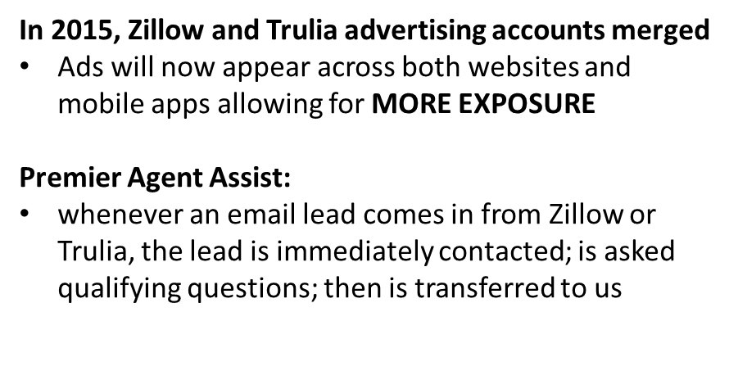
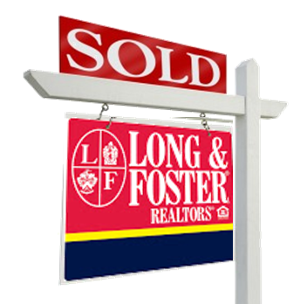

Slide 8

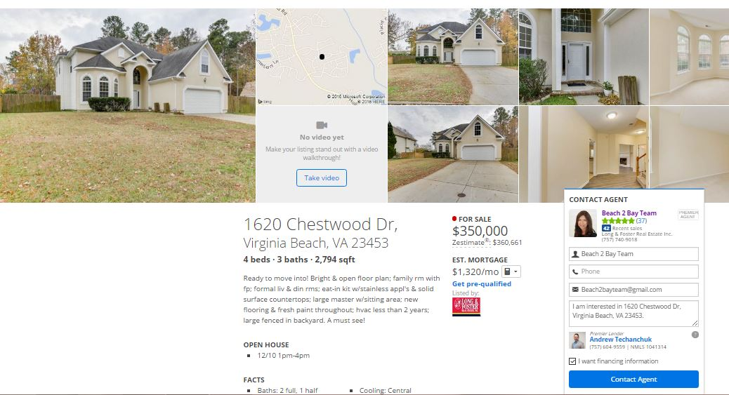
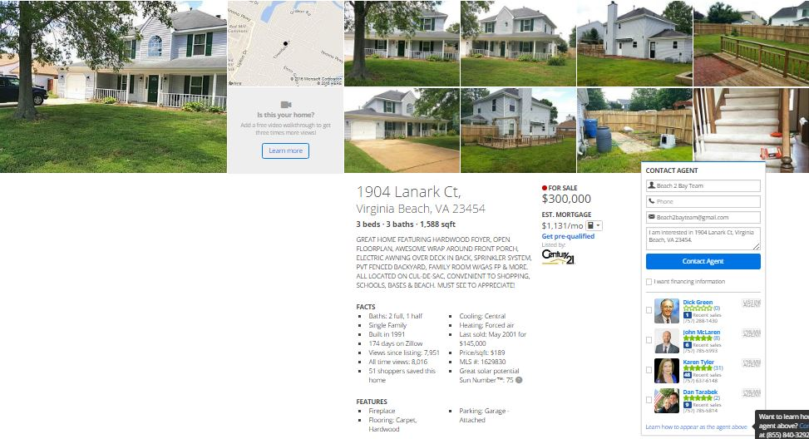
Zillow Premier Agent VS. Standard Zillow

Slide 9
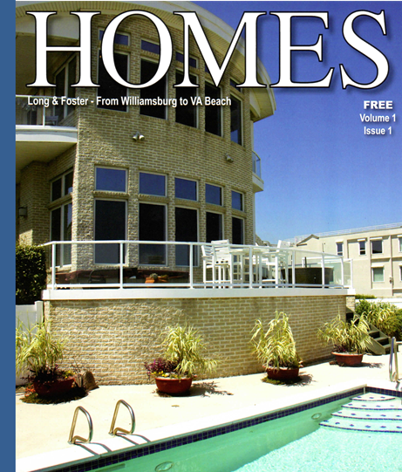
Long and Foster has launched HOMES Magazine in Hampton Roads
· Offers an EXCLUSIVE print marketing opportunity to only Long and Foster agents and their listings.
· Now available in over 80+
locations
· Distributed through inside business to over 9000 Chamber of Commerce Businesses

Slide 10
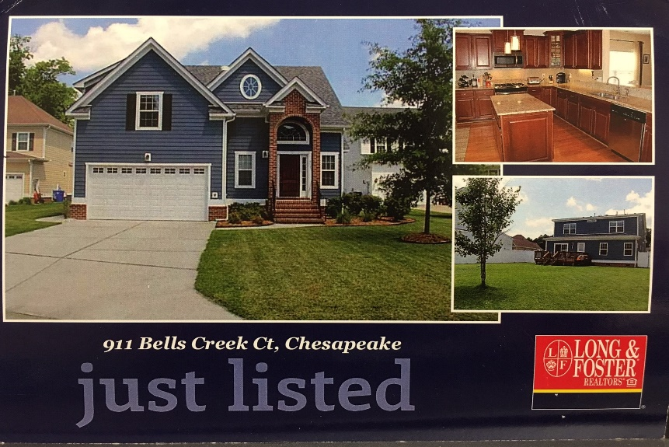
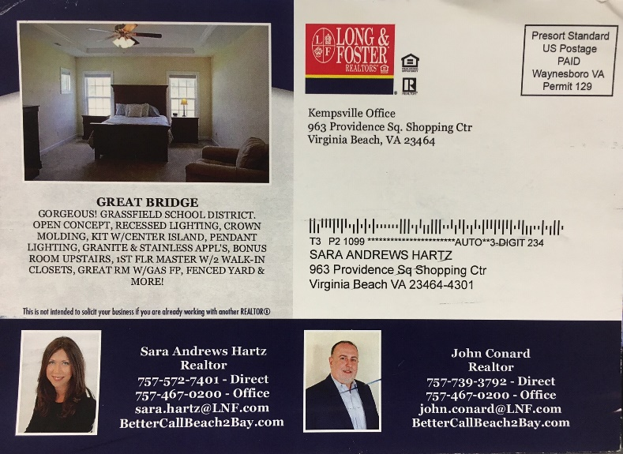
Once your home is listed, we will mail out Just Listed Postcards to your neighborhood!
FRONT
BACK

Slide 11

Your Own Home. Your Own Website.
Why have a single webpage to advertise your home when you could have a whole website instead? At Long & Foster, we do things differently. While the majority of real estate companies only create one webpage for your home, Long & Foster offers an entire website to better market—and advertise—your property!
We’re focused on getting you from your current home to your next home, so we’ve optimized the selling process with Your.Home websites!
Features & Benefits
• Superior online advertising, showing your home’s pictures and information clearly for prospective buyers.
• Improved visibility of your home in Internet search results.
• Provides a direct and simple route to view your property’s information.
• Offers visitors the ability to view and rate your home’s images.
• Features an informative, colorful brochure that includes all the information about your home for print or download.
• Provides valuable details on the neighborhood and surrounding housing market®

Slide 12


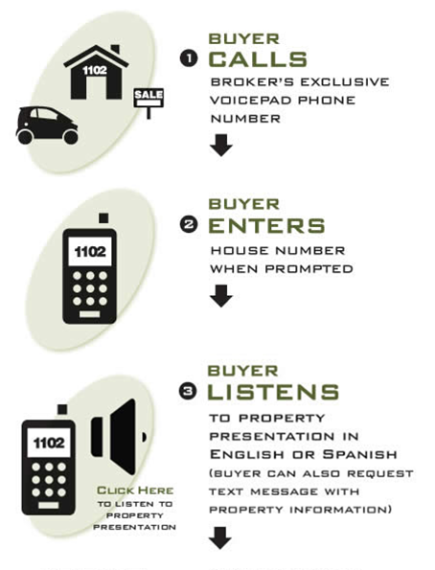
VoicePad is a multi-dimensional mobile search technology system that provides Long & Foster sales associates with the ability to track buyer inquiries, and provide prospective and current clients with the access to property information from the curbside and beyond.

Slide 13


Founded in February 2005. YouTube is the leader in online video and the PREMIER destination to watch and share original videos worldwide through a Web experience. Posting on YouTube increases your online exposure, including greater likelihood of visibility in Google searches.

Slide 14
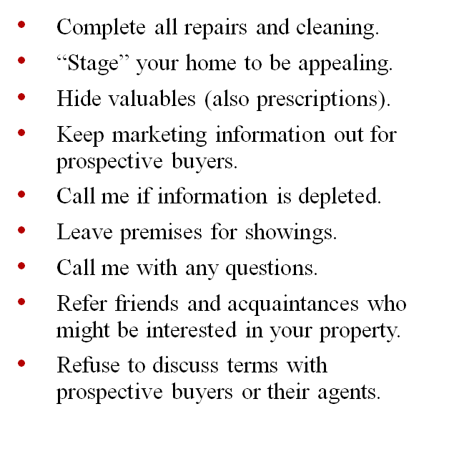
Preparing Your Home
Client Duties

Slide 15

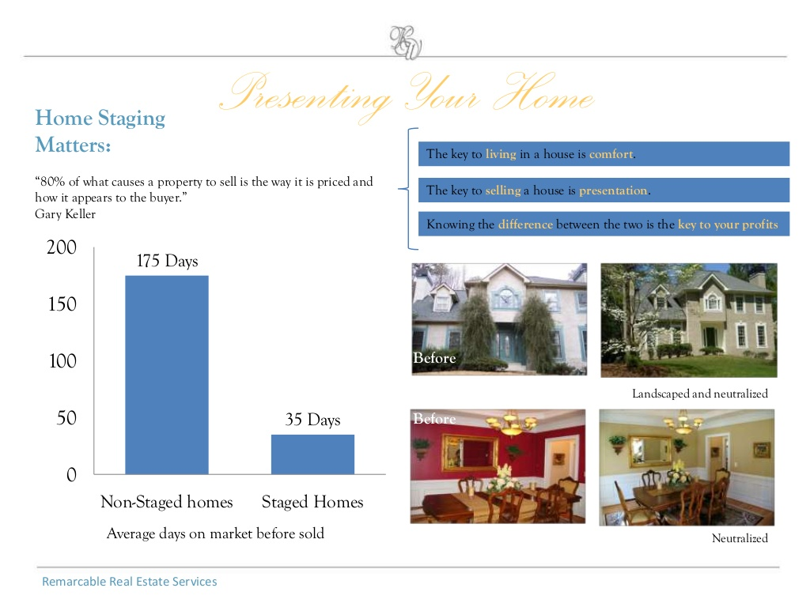
Making your Home Stand Out
The first step in the pre-marketing phase is “staging” the home. First impressions are critical!
According to HGTV, of the 25 biggest real estate mistakes,
improperly staging a home was the #1 mistake.
Pricing a home too high was #2.

Slide 16
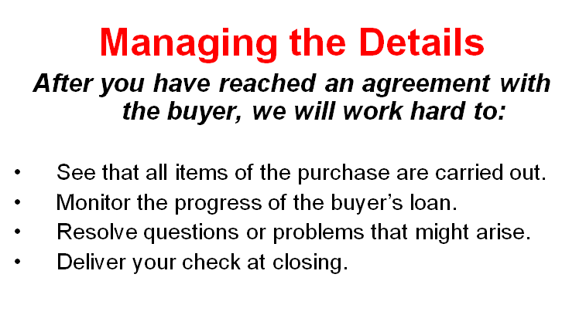
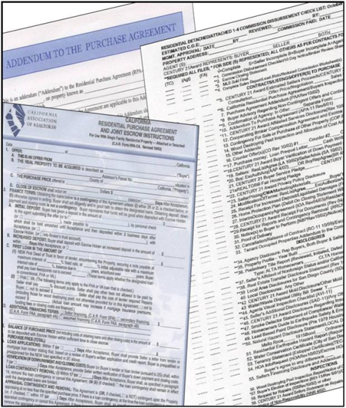
We are Trained Negotiators
It will be our job to look out for your best interest
throughout the transaction.
We will review the purchase agreement with you.
You can choose to accept, reject or counter.
We will negotiate for an agreement favorable to you.
You will be in control at every step of the transaction.

Slide 17
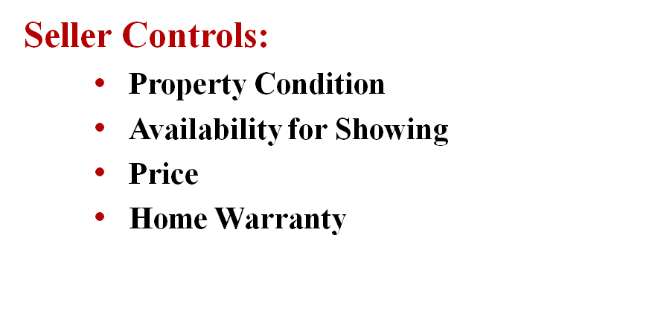

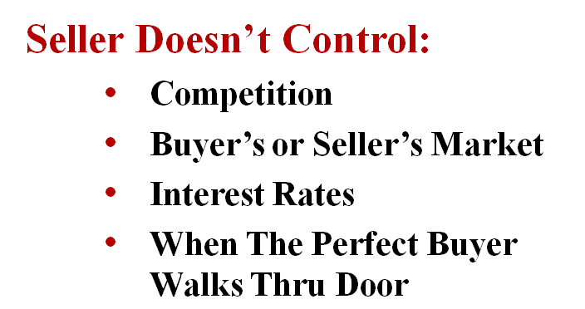
What you Do & Don’t Control

Slide 18

Home Warranty Plans
Home warranty plans go a long way to alleviate risks and concerns. For a modest price, the seller can provide to the buyer a one year warranty covering specified heating, plumbing, electrical, water heater or appliance breakdowns. Coverage under some plans will cover the home prior to closing. Thus, it provides a benefit for both the seller and the buyer. It is added value and a strong negotiation/selling point for your property.

Slide 19
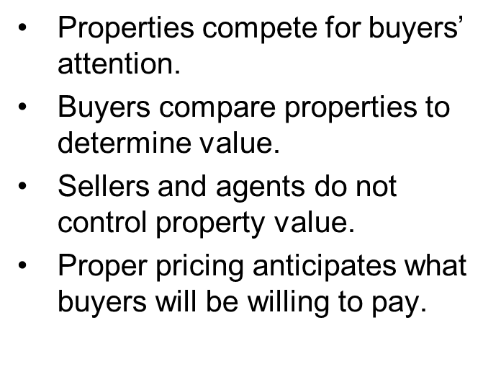
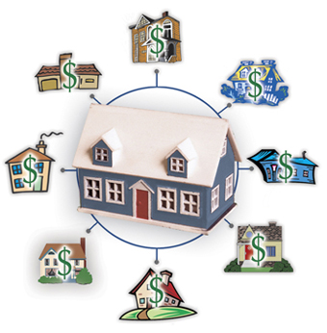
Determining Market Value
A property’s value is determined by what home buyers will pay!
People buy with emotions. Over priced homes will not allow the buyer to get emotionally involved with the home.

Slide 20
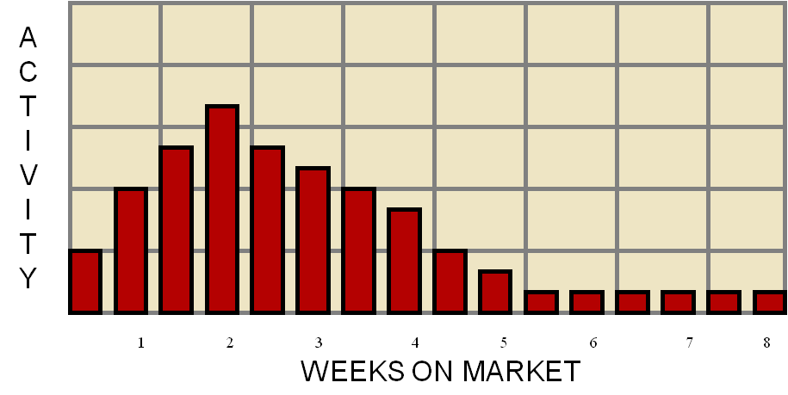
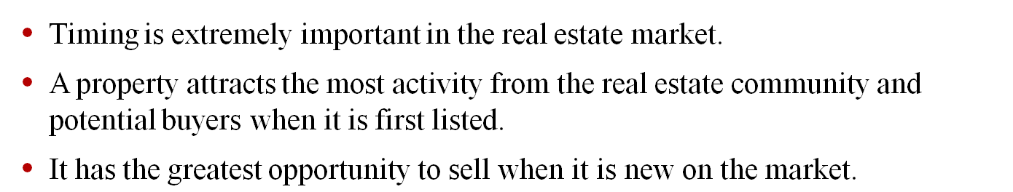
Selling Price vs. Timing

Slide 21
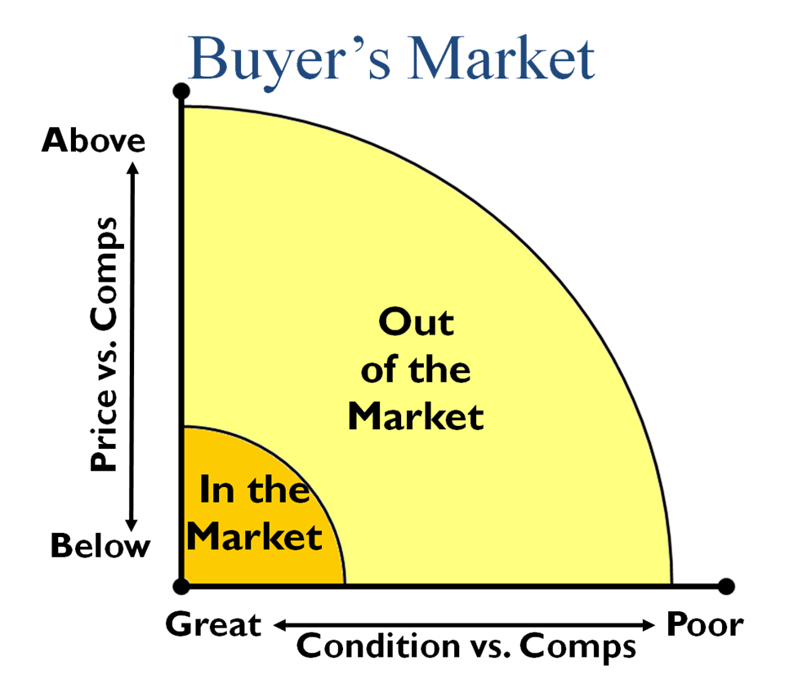
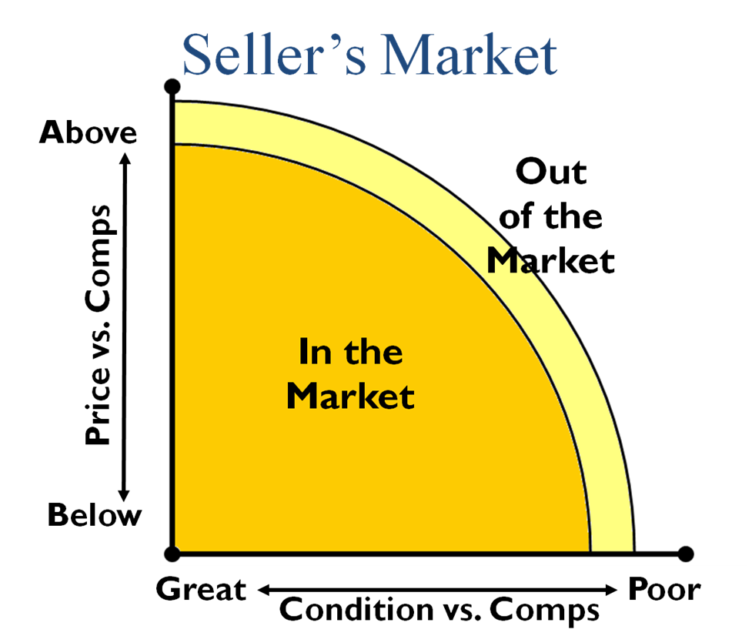
A Tale of Two Markets
Knowing the
market is key
to selling your home.
As a Realtor,
I have the necessary
expertise to help you reach your goals
successfully.

Slide 22



If for any reason we do not provide 100% satisfaction, just let us know and we promise to remedy the situation within 48 hours. If you are still not satisfied, we will release you from any listing agreement with no further obligation.
Realtor
You’re in control every step of the way!

